Slide 1
Digital Imaging

Slide 2
Rasters vs Vectors
Rasters:
    Made up of tiny dots called ‘pixels’. The word pixel is derived from the words “picture element’.
    Often referred to as “bitmap” images.
    Digital cameras record bitmap images.
    Get “pixelized” as they are enlarged, thus clarity is lost.

Slide 3
Rasters vs Vectors
Vectors
    Any image that is not a bitmap is a vector.
    Based on mathematical formulas that create lines.
    CAD software, Adobe Illustrator, Corel Draw, Macromedia Freehand and Flash are a few common places you encounter vectors.
    As these are enlarged, they do not change, thus clarity is not lost (up to a point).
http://en.wikipedia.org/wiki/Graphics_file_format

Slide 4


Bitmap or
Raster image
Vector image

Slide 6
Digital Photography

Slide 7
Why Photograph?
Enjoyment
Record keeping/documentation
Allows others to see things/places/people they would otherwise never see.
Advertising/publicity
Storytelling

Slide 8
Types of Photography
(Just how many are there?)
http://www.azuswebworks.com/photography/ph_home.html
http://www.azuswebworks.com/photography/ph_home.html

Slide 9
Which ones do you need to be concerned with?
Portrait
Landscape
Still life
Candid
Action
Nature
Animal
Historical

Slide 10
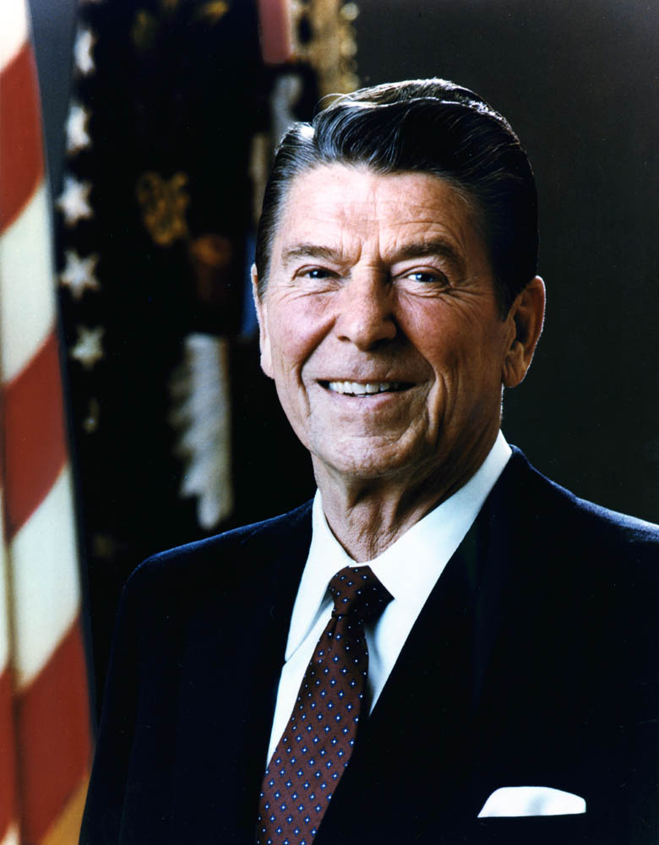
Portrait

Slide 11

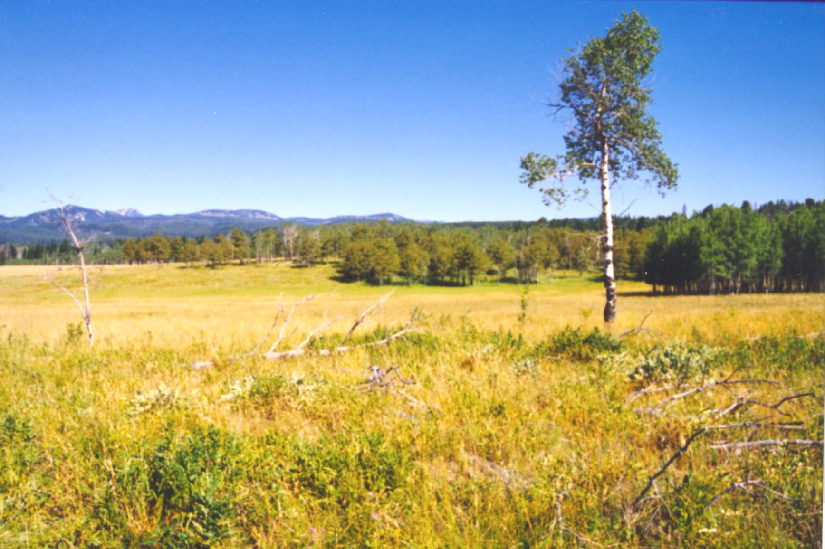
Landscape

Slide 12
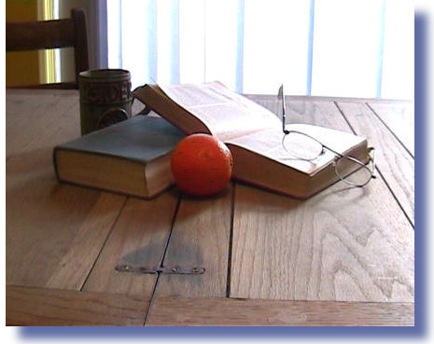
Still Life

Slide 13
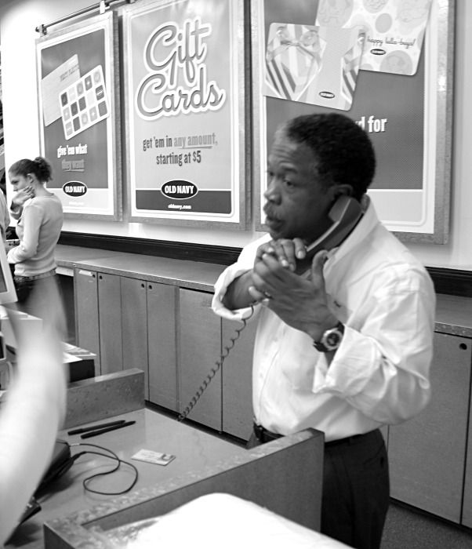
Candid

Slide 14
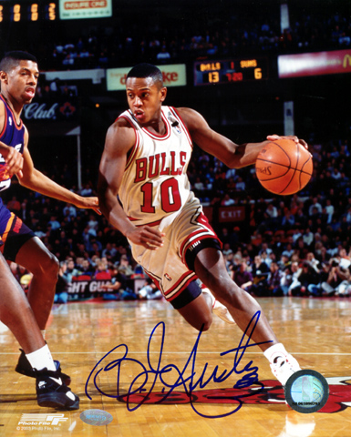
Action

Slide 15
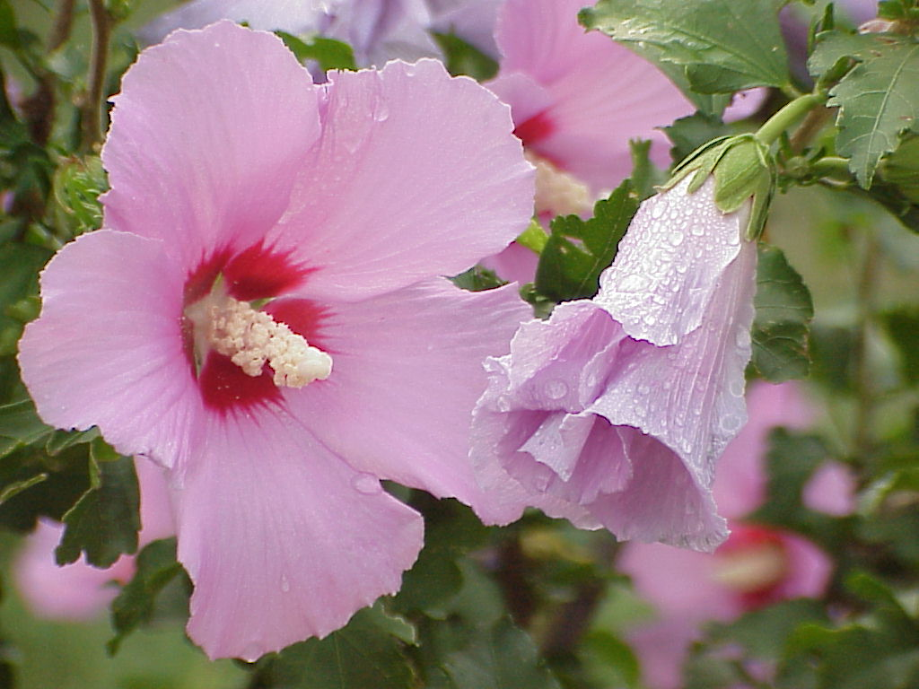
Nature

Slide 16
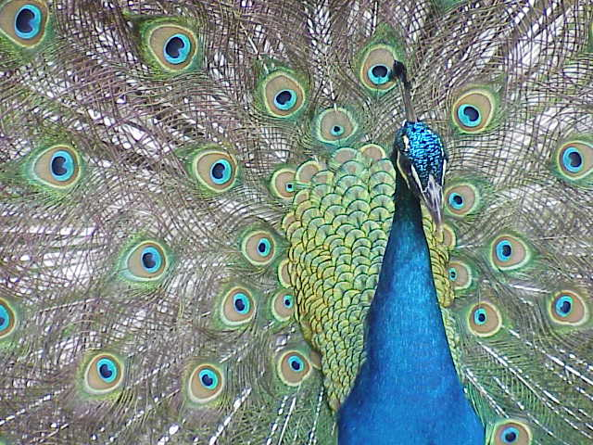
Animal

Slide 17
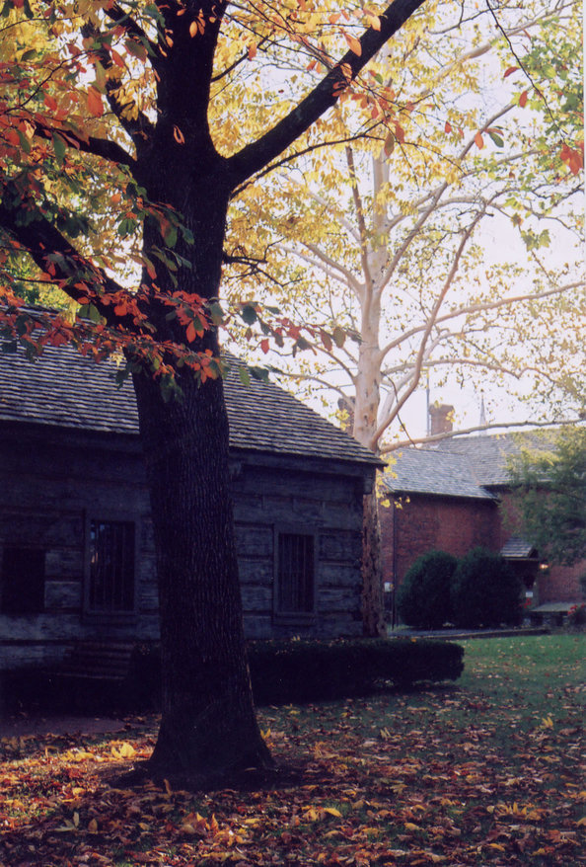
Historical
Constitution Square,
Danville, Kentucky.

Slide 19
Shooting Composition

Slide 20
Shooting Composition
Principles of Composition
  Every photograph must have a central subject or focal point.
    Develop a center of interest around which you organize the picture.

Slide 21
Shooting Composition
Principles of Composition (continued)
  The center of interest rarely belongs in the center of the picture.
    The center of a rectangle is graphically its weakest point.
    Rule of thirds
    Don’t be trapped by the focusing aid. Make focusing and framing two distinct steps.

Slide 22
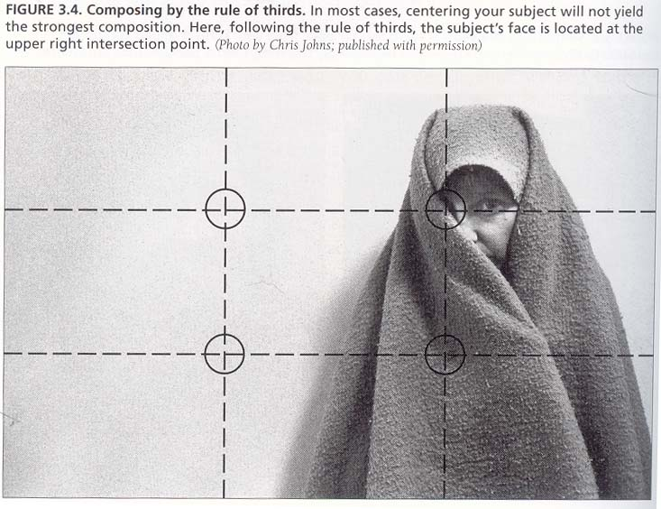
Rule of Thirds

Slide 23
Shooting Composition
Principles of Composition (continued)
  Center symmetrical subjects
    When an object is symmetrical the photograph is often most powerful when the object is centered.

Slide 24
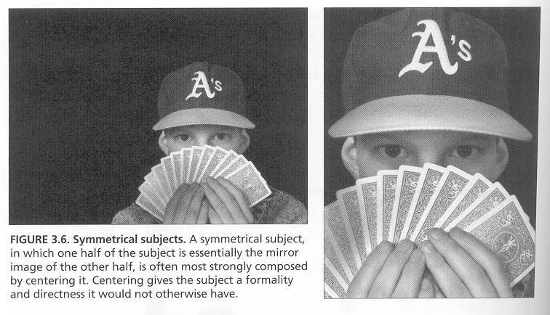
Symmetry

Slide 25
Shooting Composition
  Dominant lines help organize photographs.
    Edges, the horizon, a road, a fence, a river, a canyon, etc. all create dominant lines.
    Can create a point of interest and give the photograph direction.
    DO NOT let a dominant line divide a photo in half.

Slide 26
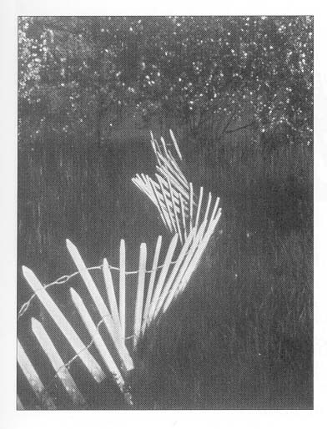
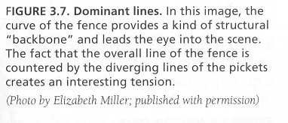
Dominant
Lines

Slide 27
Shooting Composition
Principles of Composition (continued)
  Be aware of subject-background relationships.
      Train yourself to look past the subject to study the background.
      Avoid “mergers”. This is a confusing relationship between the subject and the background.
      You, the photographer, determine whether or not the background will make the photo better, or worse.

Slide 28
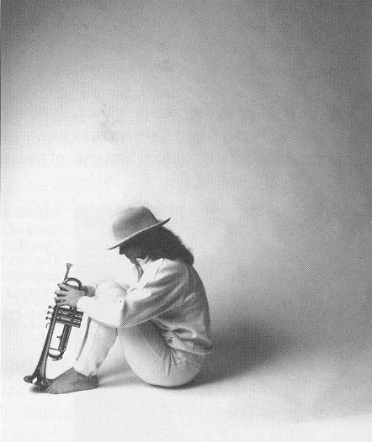
Use your background
to enhance your
subject.

Slide 29
Shooting Composition
Hold the camera properly.
Steady the camera while you shoot.
Snap the shutter properly.
  Press or squeeze the button slowly (deliberate gentleness)
  Be relaxed, take a breath, release, squeeze gently and hold still.

Slide 30
Shooting Composition
Working the subject
  Change your proximity (think like a movie director).
    Long (far) {avoid cluttered backgrounds}
    Medium
    Close (get closer!!!!)
    Watch for interesting backgrounds, effective lighting
    Vary your angle of view (vantage point)

Slide 31
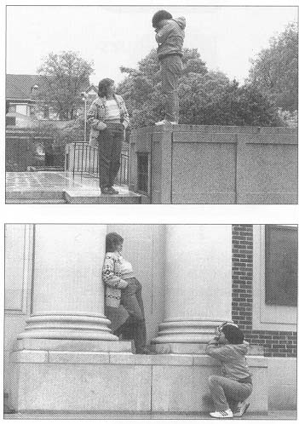
Vary
your
Angle

Slide 32
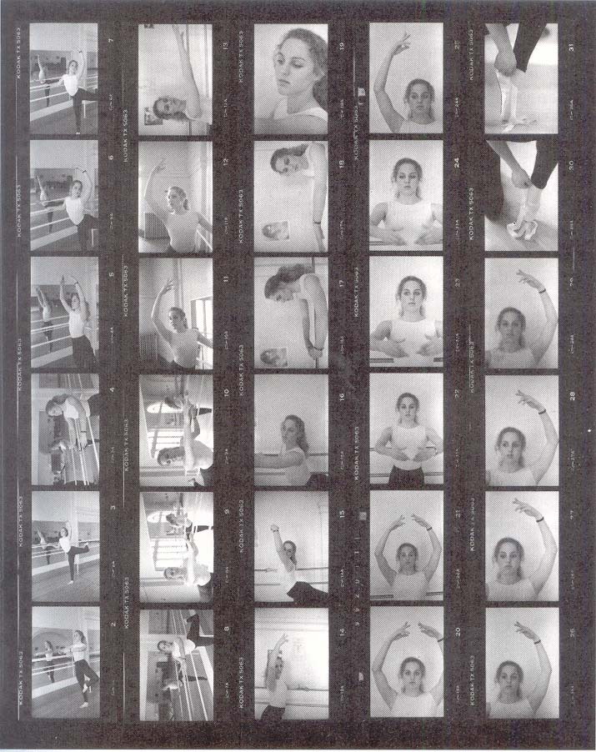
Work
your
Subject

Slide 33
Shooting Composition
Working the subject (continued)
  Frame tightly.
    This eliminates unessential and/or distracting backgrounds, adding strength to your piece.
    Included backgrounds should complement the subject.

Slide 34
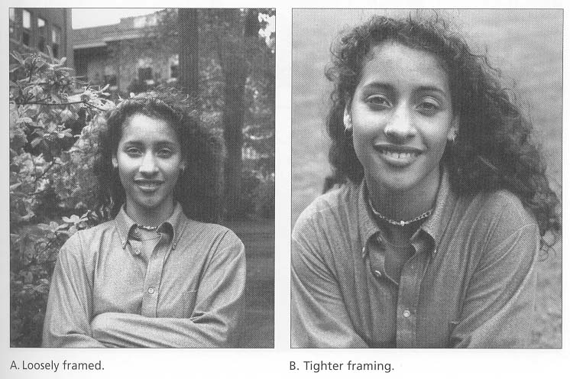
Frame Tightly

Slide 35
Shooting Composition
Working the subject (continued)
  Avoid taking all horizontal pictures.
    Frame your subjects both ways.
  Organize front-to-back as well as side-to-side.
  Emphasize nice colors, de-emphasize nasty colors.
  Experiment!!!
    Take risks.
    Enhances your growth as a photographer.

Slide 36
In summary
Good pictures result from careful attention to some basic elements of composition, together with appropriate lighting and an interesting subject.
Every photograph should have a central subject.
Use the rule of thirds.
Center symmetrical subjects.
Work your subject by changing distance and angle to your subject.
Organize your picture side-to-side as well as front to back.
Pay attention to the background.
Frame tightly to emphasize the subject.
Experiment!

Slide 37
Good Luck
with
your photography!

